Slide 1

Exploratory Data Analysis
G2M insight for Cab Investment firm
September 21st 2023

Slide 2

Agenda
Executive Summary
Problem Statement
Approach
EDA
EDA Summary
Recommendations

Slide 3
Executive Summary
XYZ is a private firm in US. Due to remarkable growth in the Cab Industry in last few years and multiple key players in the market, it is planning for an investment in Cab industry and as per their Go-to-Market(G2M) strategy they want to understand the market before taking final decision.
XYZ

Slide 4





Problem Solving
Profit Analysis
City Comparison
Gender
Age
Year over Year Δ*
* Δ is the symbol for Delta; meaning of change

Slide 5


Approach
Features: 19 Features (including 9 derived features)
Timeframe: 2016 – 2018
Total Datapoints in master_df: 359,392
Assumptions:
Profits are calculated by subtracting Cost from the Price.
Outliers found present in Price, but with no additional information of trip duration, it wont be treated as such.
Users is accounted for the number of cab users in the city, assuming it can be other cab users (including Company)
Cab_Data.csv
Customer_ID.csv
master_df
City.csv
Transaction_ID.csv

Slide 6
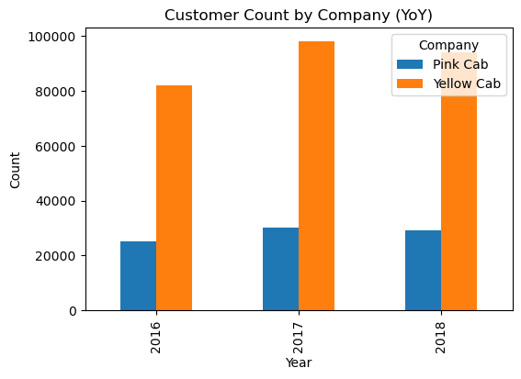
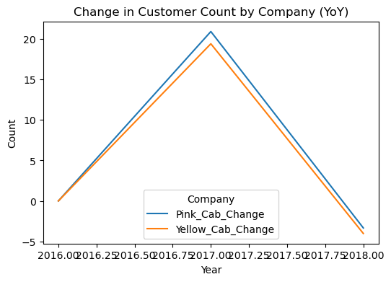
Customer Count by Company Δ YoY
Year | Pink Cab | Yellow Cab | Pink_Cab_Change | Yellow_Cab_Change
2016 | 25080 | 82239 | 0.00 | 0.00
2017 | 30321 | 98189 | 20.90 | 19.39
2018 | 29310 | 94253 | -3.33 | -4.01

Slide 7
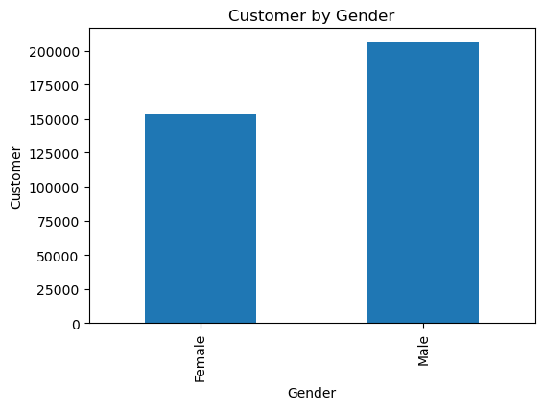
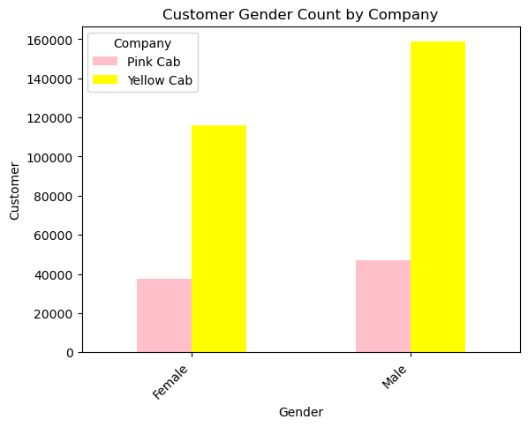
Customer by Gender
Gender | Pink Cab | Yellow Cab | Total Count | Change | Difference
Female | 37480 | 116000 | 153480 | 67.69 | 42.71
Male | 47231 | 158681 | 205912 | 70.24 | 57.29

Slide 8
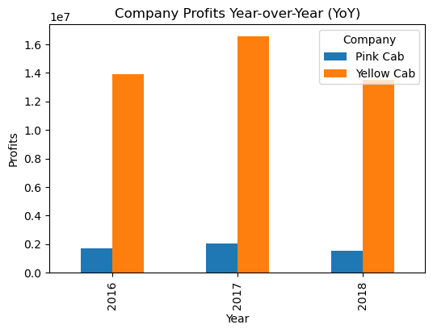
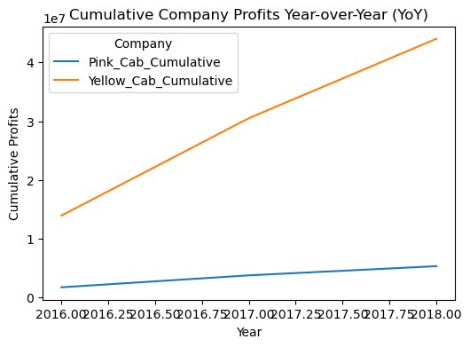
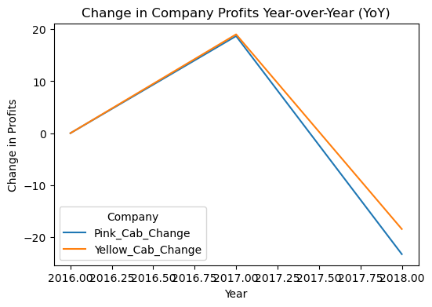
Profit Analysis
Year | Pink Cab | Yellow Cab | Pink_Cab_Change | Yellow_Cab_Change | Pink_Cab_Cumulative | Yellow_Cab_Cumulative | Pink_Cumulative_Change | Yellow_Cumulative_Change
2016 | 1713511.24 | 13926996.40 | 0.00 | 0.00 | 1713511.24 | 13926996.40 | 0.00 | 0.00
2017 | 2033655.03 | 16575977.40 | 18.68 | 19.02 | 3747166.27 | 30502973.80 | 118.68 | 119.02
2018 | 1560161.92 | 13517398.79 | -23.28 | -18.45 | 5307328.19 | 44020372.59 | 41.64 | 44.32

Slide 9
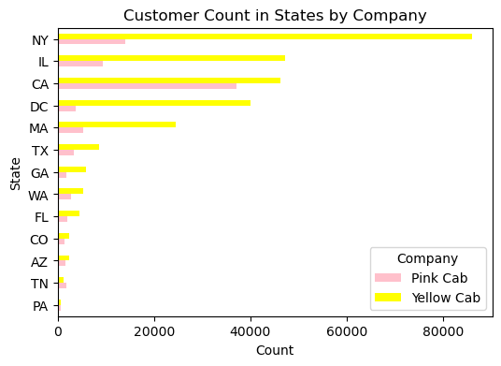
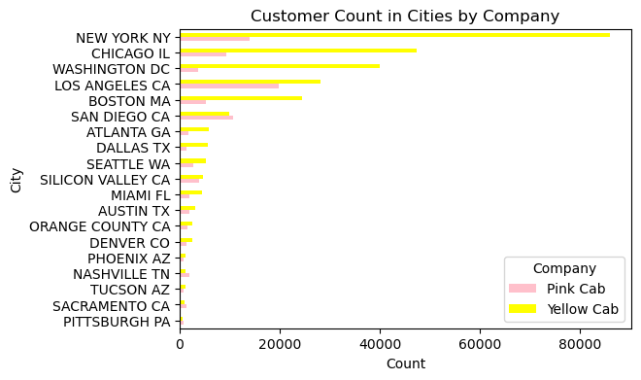
City and State Customer Count

Slide 10
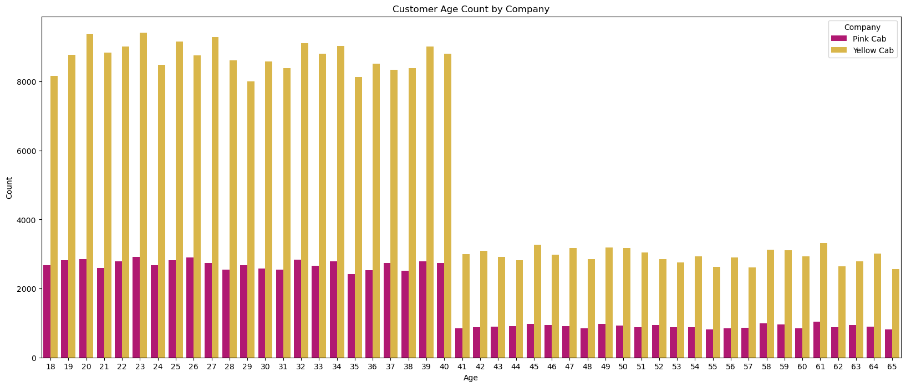
Customer Age

Slide 11
Summary
Yellow Cab has slightly higher YoY Profits entering 2017, but a smaller loss than Pink Cab entering 2018.
Profit Analysis
Overall, Yellow Cab has more market shares in the major cities in the United States of America, which contributes to more profits and clientele.
City Comparison
Most of the riders are Male, showing an increase of Male and Female passengers in Yellow Cab than its competitor.
Gender
Yellow Cab targets ages from 18-65 and has more than double customers than Pink Cab in every age category, although both companies see a dramatic drop of customers entering 41 years.
Age
Yellow Cab experiences slightly less customer count on a percentage basis than Pink Cab, and a slightly higher loss of customers entering 2018 than Pink Cab.
Year over Year Δ*

Slide 12
Recommendation
Invest in Yellow Cab
Has a higher consumer reach
More profitable
Highly regarded across large age group
Moving Forward
Market expansion into other major cities
Provide incentives for returning customers
Market company to attract customers over the age of 40.
Reduce profit loss by providing a fixed fee for certain distance to cover operation expenses.

Slide 14
Thank You

